Slide 1
2018 Section Engineers Meeting
“Materials Topics”
Michael Black
(for Allen Myers)
Division of Materials
February 6, 2018

Slide 2
March 2017 Supplemental Specifications
FHWA Stewardship Review in October 2014
Some methods of asphalt binder content determination are not “tests”
  Plant recordation (printed ticket)
  Back-calculation from G_{mm}
Only ignition oven (AASHTO T 308) and extraction (Kentucky Method 405) will be allowed
  Department personnel will utilize contractor’s ignition oven for verification testing

Slide 3
March 2017 Supplemental Specifications

Slide 4
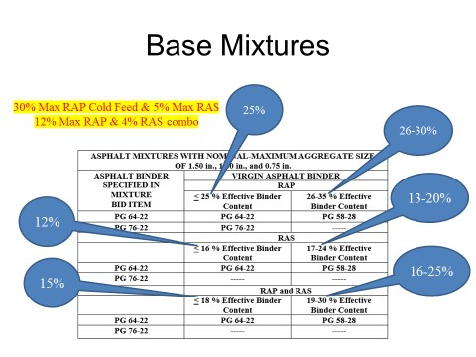
March 2017 Supplemental Specifications

Slide 5
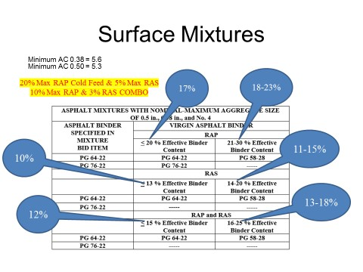
March 2017 Supplemental Specifications

Slide 6
2018 Standard Specifications
Section 802 – Type B and Type S concrete admixtures will be added (currently using KyPEL for approval)
Section 804 – Include aggregate requirements for microsurface and cold-mix patching materials
Section 805 – Proposed changes to deduction schedules for Crushed Stone Base and Dense-Graded Aggregate
Section 806 – Multiple Stress Creep Recovery test to be required for all asphalt binders

Slide 7
2018 Standard Specifications
Section 807 – Preformed Compression Joint Seals to be removed
Section 810 – Identification requirements to be added on inside of Reinforced Concrete Pipe
Section 811 – Stainless steel will not be added (continue as project-specific special note)
Section 815 – Cast Aluminum Bridge Railing Posts to be removed (lack of usage)
Section 827 – Requirements for Erosion Control Blanket to revert to version in 2000 specifications

Slide 8
2018 Standard Specifications
Sections 842 and 846 – Raise minimum contrast ratio for traffic paint from 0.97 to 0.98
Section 843 – Completely revise Geotextile Fabric requirements (thanks to Clayton Cook of Geotechnical Branch)
Concurrently update affected Kentucky Methods and List of Approved Materials
MASH versus NCHRP 350 compliance – Observe implementation dates for new requirements for guardrail, sign posts, etc.

Slide 9
Updated Asphalt Mixture Selection Warrants
Transition from “equivalent single-axle loads” (ESALs) to “average annual daily truck traffic” (AADT)
Requires lift thickness of 1.50 inches for surface mixtures (instead of previous 1.25 inches) on new construction and rehabilitation projects
Requires 0.38-inch nominal-maximum aggregate size (NMAS) for Type A and B polish-resistant mixtures in District # 3

Slide 10
Updated Asphalt Mixture Selection Warrants
Districts # 1 and # 2 will still use 0.50-inch NMAS for Type A and B polish-resistant mixtures
Requires PG 76-22 asphalt binder for AADTT ≥ 3000 (roughly equivalent to 10 million ESALs)
Includes “No. 4 nominal” or “thinlay” mixtures
Updated warrants available on Division of Materials website

Slide 11
General issues
Submit samples that require testing by Division of Materials in timely fashion
Apply materials deductions to project items as required
Obtain roadway samples of asphalt mixtures on projects requiring polish-resistant aggregate
Notify Division of Materials about high-friction surface projects so that material can be sampled and treatment can be skid-tested

Slide 12
Total number of contracts certified

Slide 13
Percentage of completed contracts without deficiencies

Slide 14
Total number of bid item deficiencies/ Number of contracts with deficiencies

Slide 15
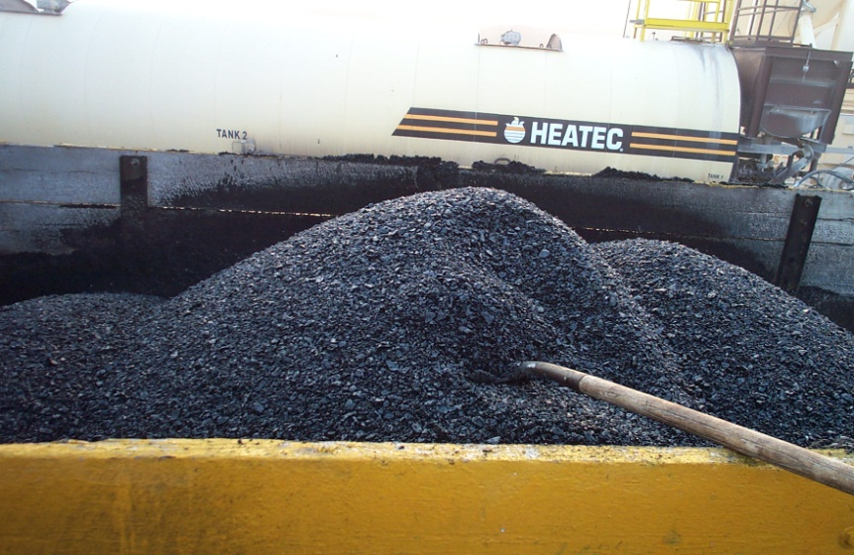
Most frequent types of sampling deficiencies
No sample/insufficient number of samples taken
Data entry error (loading spreadsheets into SiteManager Materials)
No asphalt/concrete mix design obtained
No certification/insufficient number of certifications obtained

Slide 16
AASHTOWare Project Construction & Materials
Comprehensive, web-based module
  Covers complete construction and materials management process
  Includes laboratory information management functionality
Powerful application spanning all levels of construction and materials management
  Enables personnel to progress contract and supporting documentation from award through finalization

Slide 17
AASHTOWare Project Construction & Materials
Able to receive proposal data from AASHTOWare Project Preconstruction and pass data to and from AASHTOWare Project Civil Rights & Labor
Able to use on any computer, laptop, or other device with internet connection
Replaces current SiteManager and LIMS
Begins in 2018, but full implementation will probably require two or three years

Slide 18
Points of emphasis for 2018
Get those samples and certifications!
  Especially traffic paint, cement, fly ash, and SS-1h emulsion
Ask for help when encountering problems with uploading mix design spreadsheets and AMAWs
Collect required certifications
Complete older contracts before busy construction season starts
Have a safe and successful year!

Slide 19


2018 Section Engineers Meeting
Allen H. Myers
Division of Materials
Phone: 502-564-3160
Fax: 502-564-7034
E-Mail: Allen.Myers@ky.gov
THANK YOU!

Slide 20

2018 Section Engineers Meeting
“Hollywood”
11/11/17

